Slide 1

Analysis 1: Foundations of Modeling Lesson 4.2: Cyclic algorithms
Analysis Team, 2020/2021

Slide 2
Overview of this lesson: Cyclic algorithms
Cyclic algorithms,
While loop,
Exercises.

Slide 3
Overview of this lesson: Cyclic algorithms
Learning objectives:
Learn about iterations and cyclic algorithms.
Know the syntax of the while loop.
Understand the initialization section, testing and the body of a loop.
At the end of the lesson a student should be able to:
Identify the types of problems that require cyclic algorithms.
Apply the knowledge of while loop to solve problems.
Combine cyclic with linear and branching algorithms in problem solving.

Slide 4
Cyclic algorithms

Slide 5
Cyclic algorithms
In lesson 1.2 we categorized algorithms according to the way the steps are executed into:
Linear
Branching
Cyclic

Slide 6
Cyclic algorithms
Similar to branching algorithms, cyclic algorithms have condition and body.
If the condition is evaluated as true, the steps in the body will be executed. If not, the steps in the body will be skipped.
However, once the steps in the body have been executed, the algorithm will “jump back” to the condition again and perform the evaluation.
This means that the steps in the body will be executed over and over again, as long as the condition remains true.

Slide 7
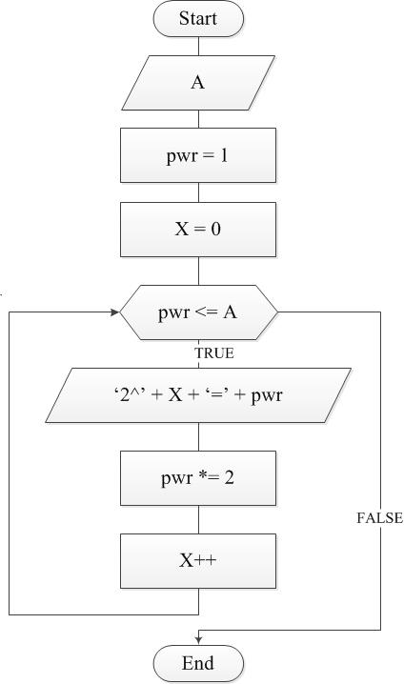
Cyclic algorithms
Algorithms that contain steps that, depending on condition, can be executed once, multiple times or never.
Depending on the program logic, some steps may be executed several times.

Slide 8
Cyclic algorithms
One iteration – execution of all steps in the body of the cyclic algorithm.
Depending on condition, there can be zero, one or more iterations.
Different programing languages implement cycles where the condition can be evaluated BEFORE the body and / or AFTER the body.
Cycles where the condition is checked after the body can have 1 or more iterations.
Cycles where the condition is checked before the body can have 0 or more iterations.

Slide 9
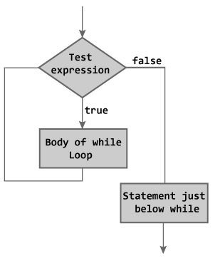
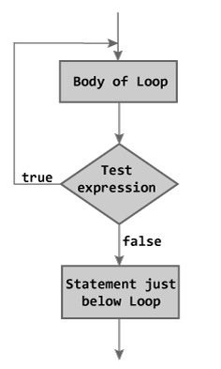
Cyclic algorithms
Condition before body
Condition after body

Slide 10
Cyclic algorithms
In this course we will focus only on cycles where the condition is evaluated BEFORE the body.
In Python we will learn to use two loops:
While loop,
For loop.

Slide 11
While loop

Slide 12
While loop
While loop is a control flow statement.
As long as the condition is satisfied, the steps in the body will be executed repeatedly.
Please note: although the steps will be executed over and over again, the variables (are expected) to change. That is the main purpose of while loop.
Every other loop can be written as the while loop.

Slide 13

Cyclic algorithm 1 – sum of N numbers
To understand while loop, let’s dive in into a typical problem …
Problem statement: Write an algorithm that will calculate the sum of N numbers inputted. The numbers are read from the standard input as long as the user doesn’t enter 0. Upon entering 0, the cycle should stop and the sum should be printed out.
Note: Remember our “Max” example in lesson 6?
This time we will apply the similar procedure
but inside of a loop.

Slide 14
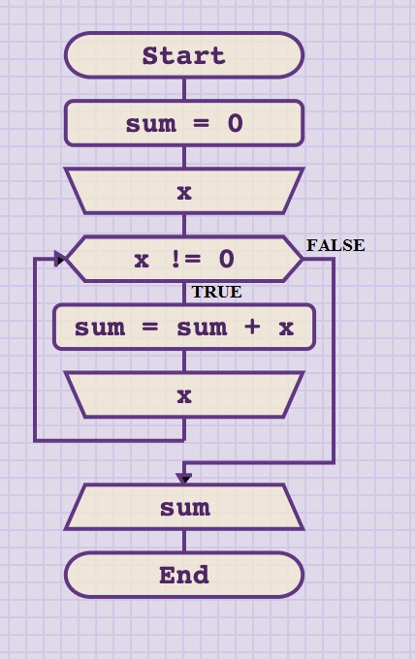
Cyclic algorithm 1 – sum of N numbers
To solve this problem we can use the following algorithm:

Slide 15
Steps before while loop
while loop
condition
body
Steps after while loop

Slide 16
Cyclic algorithm 1 – sum of N numbers: initialization
In almost every case, we have to initialize some variables before entering the loop.
In this example we decide to use variable SUM to store the sum of all values entered.
This means this variable has to be set to specific value before entering the loop. In our case, we want it to be 0.
Also we decide to use variable X to store input from the user.
We have to read the first X before the loop, or there would be no condition to evaluate.

Slide 17
Cyclic algorithm 1 – sum of N numbers: iteration
The while loop consists of condition and body.
First we start with the condition, where we check if X is NOT EQUAL to 0.
If the condition is not satisfied (i.e. user has entered 0), the body of the while statement will be skipped…
… and we will print out the sum, which will be 0 (as we haven’t added any value).

Slide 18
Cyclic algorithm 1 – sum of N numbers: iteration
However, if the user had entered anything but 0 …
… the condition will be evaluated as true.
Then, the algorithm will continue with the steps inside the body of while loop:
Increase the SUM by X.
Ask the user to enter another value for X.
Repeat. (return the execution flow back to the condition and evaluate again)

Slide 19
While loop – Python syntax
To use while loop in Python, we have to start with the keyword while.
After while, we must give an expression (Boolean value or condition).
After expression we use : sign to denote the end of expression.
At the end (new line, plus indentation) we add one or more statements (program lines) that are the body of while loop.

Slide 20
While loop – Python syntax
This is some expression that must evaluate to True or False.
E.g. A > 0, M != N, not(P and Q), …
Let’s take a closer look:
while expression:
statement(s)
‘ : ‘ denote the end of expression
One or more program statements.
It is these statements that will be
executed as long as the expression == True.
This is the keyword that tells Python we are using WHILE loop

Slide 21

Cyclic algorithm 1 – sum of N numbers
Now that we know the syntax for while loop, let’s implement this algorithm in Python.

Slide 22
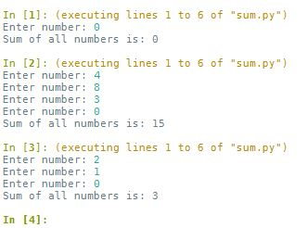
Cyclic algorithm 1 – sum of N numbers
Finally, let’s test it to confirm that we did a good job.
Try: Case 1: 0 → 0
Case 2: 4, 8, 3, 0 → 15
Case 3: 2, 1, 0 → 3

Slide 23
Cyclic algorithm 1 – sum of N numbers
Let’s consider the same problem, but assume that we made a mistake in designing the algorithm.
We forgot to input the new value for X inside of while loop.
What do you think would happen?

Slide 24
Infinite / dead loop
If we enter any number for X except 0 …
… the condition will ALWAYS evaluate as TRUE.
As the consequence, the algorithm will be FOREVER stuck in the cycle, increasing the sum by x over and over and over and over and over ….
… until you forcefully stop it – terminate.
This is called infinite or dead loop and is one of the very common programming mistakes.
Notes:
NOTE: there are specific conditions when you want to create infinite loop on purpose (mostly graphics and event driven programming), and then break out of it for specific condition. These cases will not be considered in this course.

Slide 25
Cyclic algorithm 2 – input number
So far, we relied on our user to give the proper input(s) to our program(s).
Often, that is not the case, and users have the tendency to be “creative” and input all kinds of values we do not want, typically making our programs to crash.
As a good programming practice, we want to handle such cases and prevent undesirable values in our programs.
We will start with such a case …

Slide 26
Cyclic algorithm 2 – input number
Problem statement: Ask the user to input (whole positive) number X. Repeat the process until the valid input is given.
! Note: the “proper” solution is to use try … catch … statement combined with type() function. However, this is more advanced from the topics covered in Analysis 1.
Hence, we will help ourselves with .isnumeric() method which works for whole numbers. For a given string S, S.isnumeric() will return TRUE if S is whole positive number. Otherwise, it will return FALSE.
This is for illustration purposes only! You don’t have to learn this method.

Slide 27
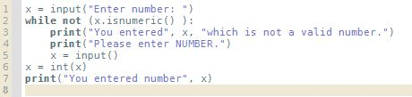
Cyclic algorithm 2 – input number
Let’s dive into the code directly …
1: we assign the value to x from the standard input (console)
2: we set the condition x.isnumeric(), which will return True for natural numbers.
If line 2 evaluated to be False, then we know we have the proper input (as .isnumeric() = True, and Not True = False) the algorithm goes to line 6, where we convert the string to integer and print it out.

Slide 28
Cyclic algorithm 2 – input number
In case the user entered anything but the natural number …
… then .isnumeric() will return False. Negating False, gives us True, which satisfies the condition and enters the body of the while loop.
We present the message to the user that we want different input.
And ask for the new value again.
And repeat as long as we don’t get what we want. ☺

Slide 29
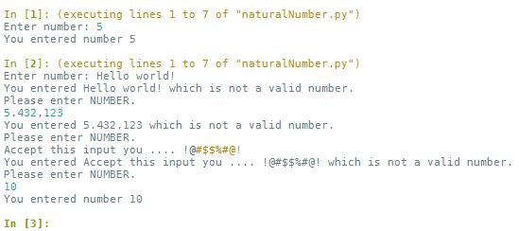
Cyclic algorithm 2 – input number
Here we can find our algorithm in action.
In case 1 we entered the proper input and we don’t go into the while loop.
In case 2 user didn’t comply with our requests, so we keep him in the loop as long as we don’t get what we want.

Slide 30
Cyclic algorithm 3 – hello world x N
Often, you will want to execute steps inside of a cycle specific number of times. We will show this with the following problem:
Problem statement: Ask the user to input natural number N. Then, print “Hello world!” N times.

Slide 31
Cyclic algorithm 3 – hello world x N
Let’s analyze and decompose the problem:
We know we have to print(“Hello world”).
We also know we have to do it N times, therefore, we can’t use linear nor branching algorithm. So, it must be cyclic.
The steps in the cyclic algorithm are executed while the condition is True. So, we have to make such condition which will be True N times, and not N+1 time.
It becomes apparent that we need to COUNT the number of iterations.

Slide 32
Cyclic algorithm 3 – hello world x N
Counting iterations is one of the fundamental problems in programming.
To implement it we need one variable that will count each iteration.
To do so we have to:
Initialize that variable to the desired starting value.
Increment that variable after each iteration.
It is an informal convention to use name ‘i’ for variable counting iteration. Then, ‘j’, ‘k’, …

Slide 33
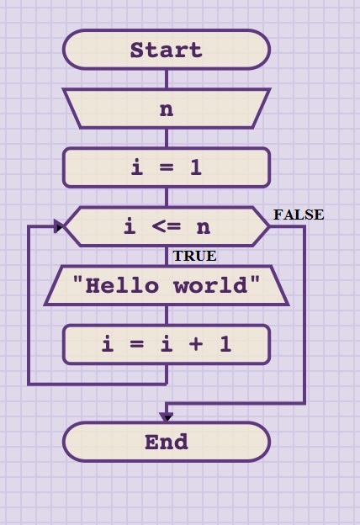
Cyclic algorithm 3 – hello world x N
Let’s take a look at the solution:
We read value for N.
Next, we have to initialize the counter.
Then we start the cycle with the condition: to repeat while I <= N.
As long as the condition is satisfied, we will print “Hello world”
At the end, we must increment our counter I, or we end up with infinite loop.

Slide 34
Cyclic algorithm 3 – hello world x N
Exercise:
Implement the algorithm in Python.
Time: 5 min.

Slide 35
Cyclic algorithm 3 – hello world x N
Discussion:
Be careful about condition(s) and initialization!
Some programmers prefer to count from 1. Others prefer to count from 0.
In this example, if we start counting from 1, then to ensure the correct number of iterations, we have to set the condition to: I <= N.
However, if we start counting from 0, then the condition must be set to I < N.

Slide 36
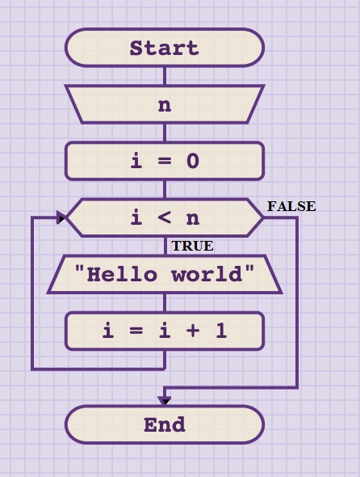
Cyclic algorithm 3 – hello world x N

Slide 37
Cyclic algorithm 4 – range
EXERCISE: Ask user to enter 2 integers M and N such that M < N. Then, print all numbers from M to N including M and N.
Sketch the flowchart first.
Test the algorithm.
Implement in Python.
Test in Python.
Time: 10 minutes.

Slide 38
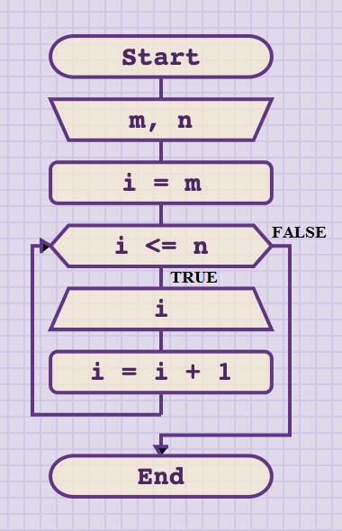
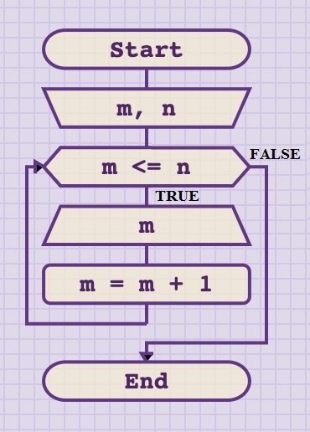
Cyclic algorithm 4 – range
solution - flowchart
Since we don’t have to preserve M, we could have used it as the counter, drop I and save one step.
Still, the solution on the left is recommend until you gain more experience.

Slide 39
Cyclic algorithm 5 – even numbers
EXERCISE: Ask user to enter 2 integers M and N such that M < N. Then, print all EVEN numbers from M to N including M and N.
TIP: this problem requires to combine branching and cyclic algorithm. Do you remember how to use MODULO operation?
TIP 2: The IF statement should be INSIDE the body of the cycle.
Sketch the flowchart first.
Implement in Python.
Time: 10 minutes.

Slide 40
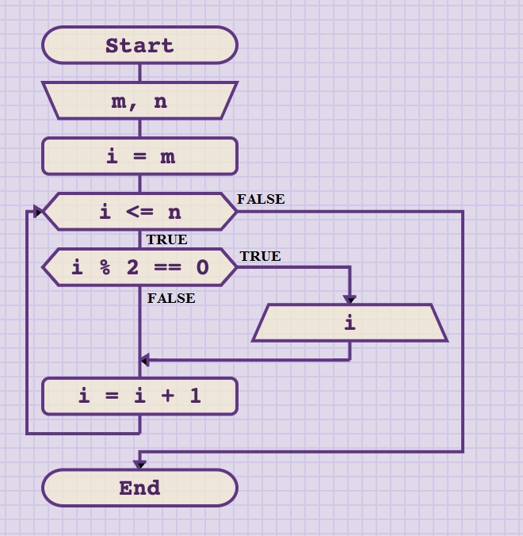
Cyclic algorithm 5 – even numbers
solution - flowchart

Slide 41
Cyclic algorithm 6 – prime number
PROBLEM STATEMENT: Read natural number N. Then check if N is a prime number. If prime, print “N is prime”. Otherwise, print “N is not prime”.
Note: A prime number (or prime) is a natural number greater than 1 that has no positive divisors other than 1 and itself. The number 1 itself does not count as prime. The first few primes are 2, 3, 5, 7, 11, 13, 17, 19, …

Slide 42

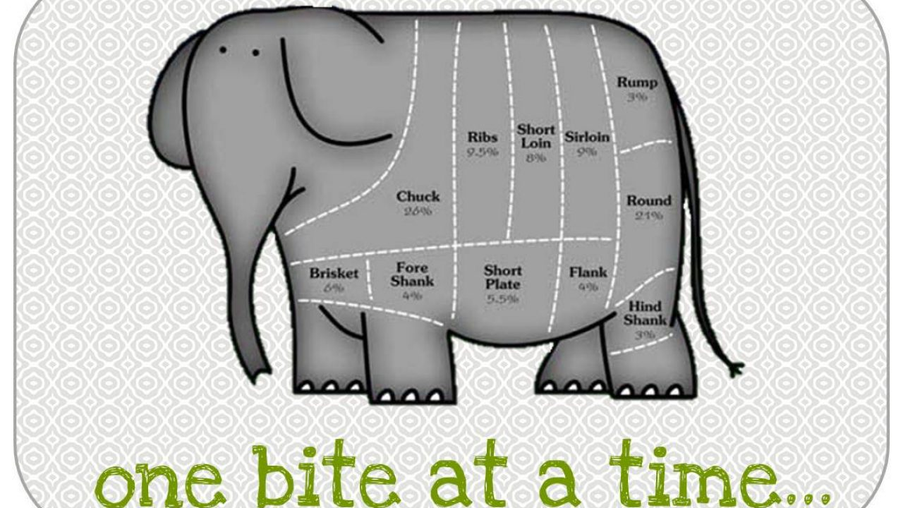
Cyclic algorithm 6 – prime number
How do you eat an elephant?
One bite at a time …
If stuck, remember the joke about problem solving and “eating an elephant”?

Slide 43
Cyclic algorithm 6 – prime number
DISCUSSION:
How would you solve the problem?
To check if number N is prime, we have to test dividing it will all numbers in interval [ 2 .. N-1 ].
Ok, that means we have to generate all numbers from that interval, and we just practiced how to do that.
To test if some number is divisible, all we have to do is use floor division and check the remainder.
Sub problem: that means we have to store N-2 boolean variables!!??
Not in this case. We only need one. This will be the hypothesis that the number is actually prime. If only one division has no remainder, the hypothesis is violated and we change that boolean variable to False.
Finally, we just check that single boolean variable.

Slide 44
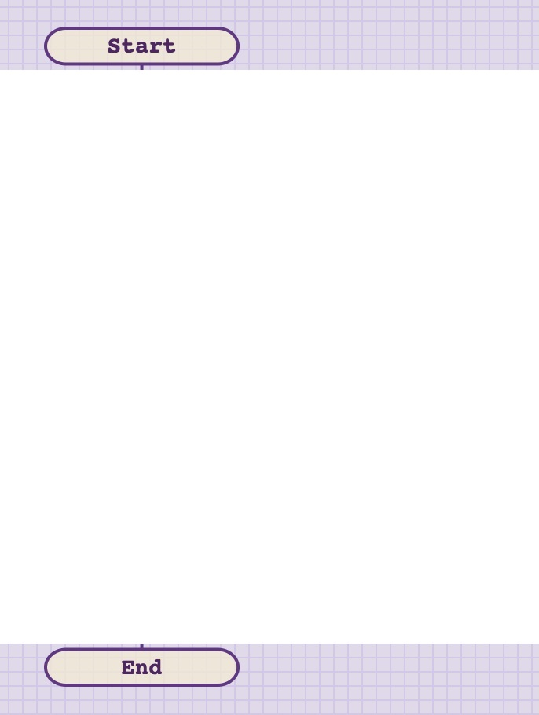

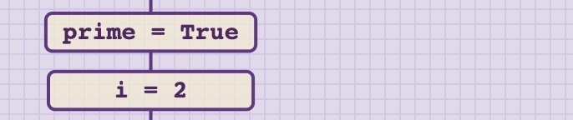
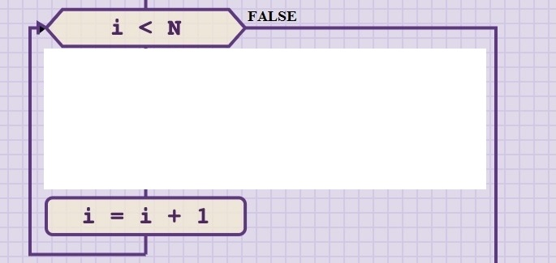
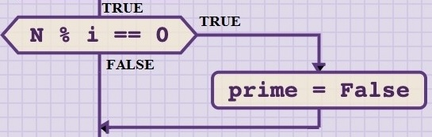
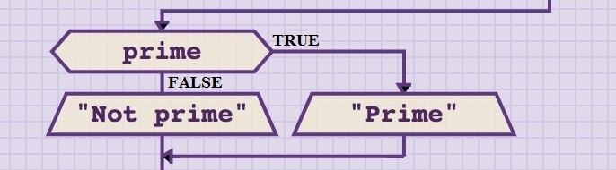
1. Start sketching the flowchart
2. Read N
3. Create a while loop for
interval [2, N)
4. Initialize variables
5. Check the remainder to test
if the number is divisible,
and adjust the boolean
variable if so
6. Check boolean variable and
give the appropriate printout

Slide 45
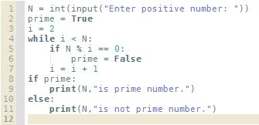

Cyclic algorithm 6 – prime number

Slide 46
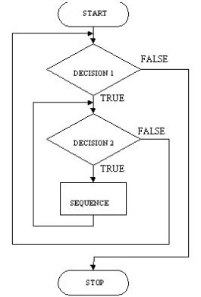
Nesting loops
As we did with IF statements, we can also nest loop inside of a loop.

Slide 47
Nesting loops
Question: If we have one loop that will iterate 5 times, and another loop nested inside that will iterate 10 times. How many times will the statements inside of the nested loop be executed in total?
Answer: 50
Because for each iteration in the outer loop, all 10 iterations in the nested loop will be executed. Therefore, the total number of times the steps inside of a nested loop are executed will be 5 x 10 = 50.

Slide 48
Cyclic algorithm 7 – list prime numbers
EXERCISE (HOMEWORK): Read natural number N. Then, print all prime numbers from interval [2, N]
Tip: You can use the solution from the previous example, and wrap around it another while loop for range 2 – N.
Modify the output accordingly.
Sketch the flowchart.
Implement in Python.
Test.

Slide 49
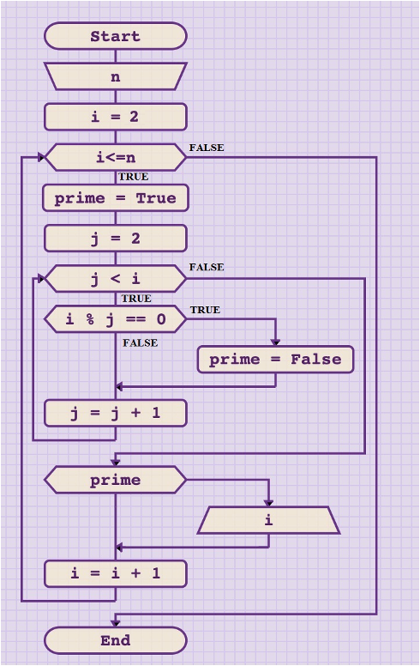
Cyclic algorithm 7 – list prime numbers
solution - flowchart

Slide 50
Cyclic algorithm 8 – sum and average
EXERCISE (HOMEWORK): Read numbers from the standard input until 0 is entered. Then, print their sum and average value.
Sketch the flowchart.
Implement in Python.
Test.

Slide 51
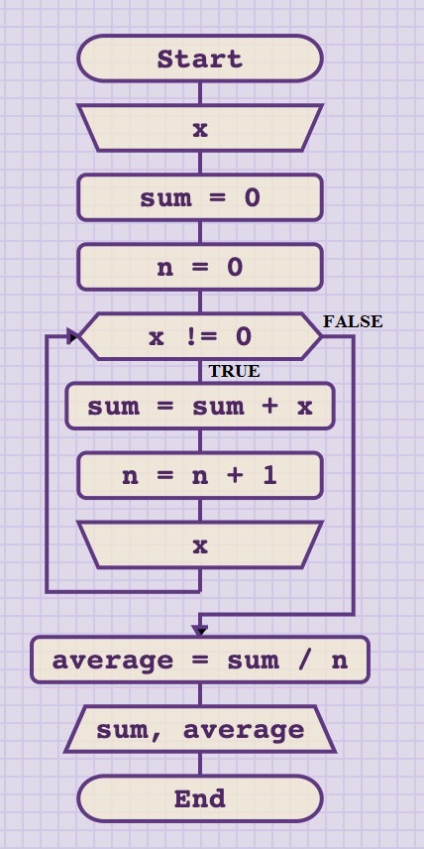
Cyclic algorithm 8 – sum and average
solution - flowchart

Slide 52
Cyclic algorithm 9 – “guess the number” game
CHALLENGE: Sketch the flowchart and then implement in Python “guess the number” game.
Game rules: The computer picks at random one number from the interval [1, 100]. The player has to guess that number and has 5 attempts to do so. In each attempt the player enters his guess.
If the guess is equal to the number computer picked, player wins, the computer prints appropriate message (e.g. “you win”) and the game ends.
If the guess is lower the target number, computer prints that the target is higher and vice-versa (if guess is higher, computer informs that the target is lower than the guess). The player has one attempt less after each guess.
The game ends when player has no more attempts left, or if the number was guessed. If player failed to guess the number after all 5 attempts, the computer should print what was the target number and inform the player that he lost.

Slide 53
Cyclic algorithm 9 – “guess the number” game
All elements to solve this problem have been covered in the course so far, except how to generate random numbers.
NOTE: choosing random number is not part of this course, therefore you are provided solution that can be copy-pasted, without going into details.
In short, you must import Python module with function to generate random numbers, random. This is done by typing: import random.
After importing the module, you can use function random() to generate any random value (float) in interval [0, 1). Example: x = random.random()
Alternatively, you can use randint(a,b) function that returns random value from interval [a, b]. Example: x = random.randint(1, 100)

Slide 54
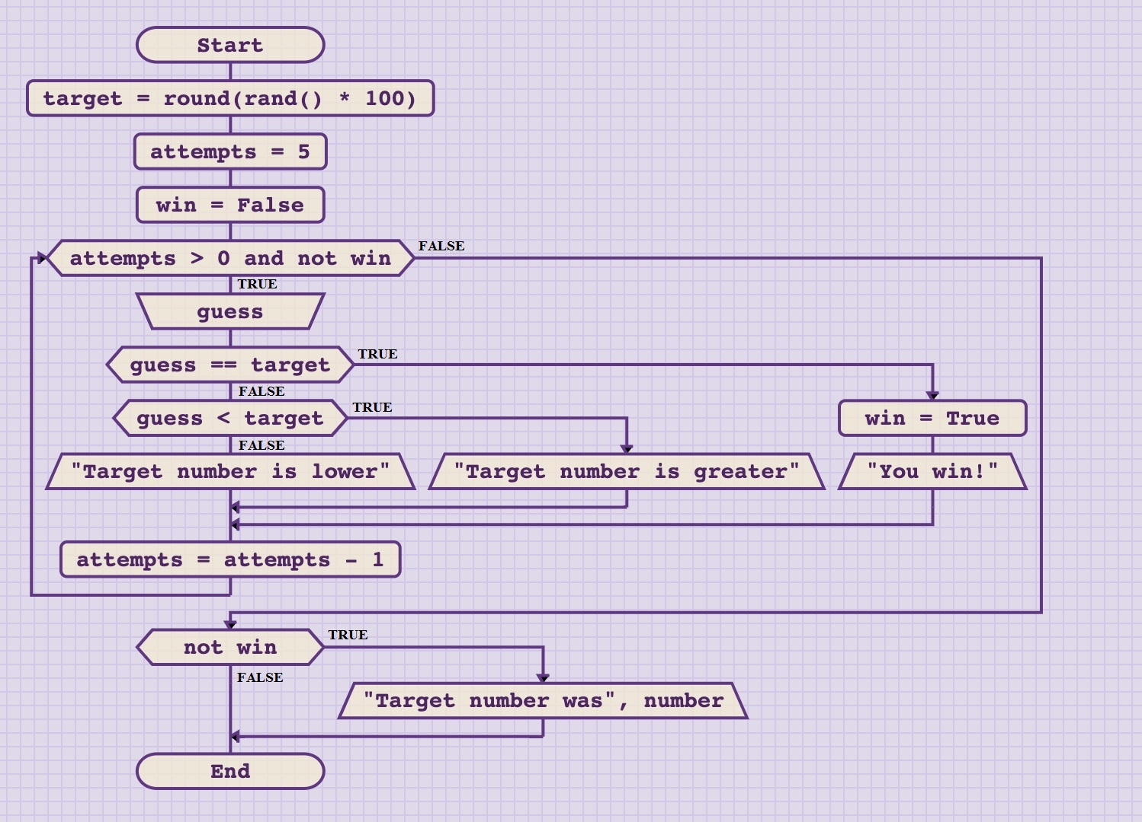
Cyclic algorithm 9 – “guess the number” game
solution - flowchart

Slide 55
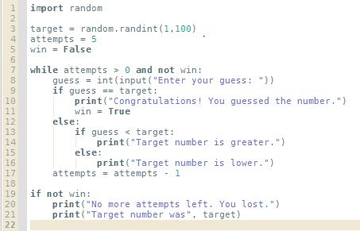
Cyclic algorithm 9 – “guess the number” game
solution – Python implementation

Slide 56
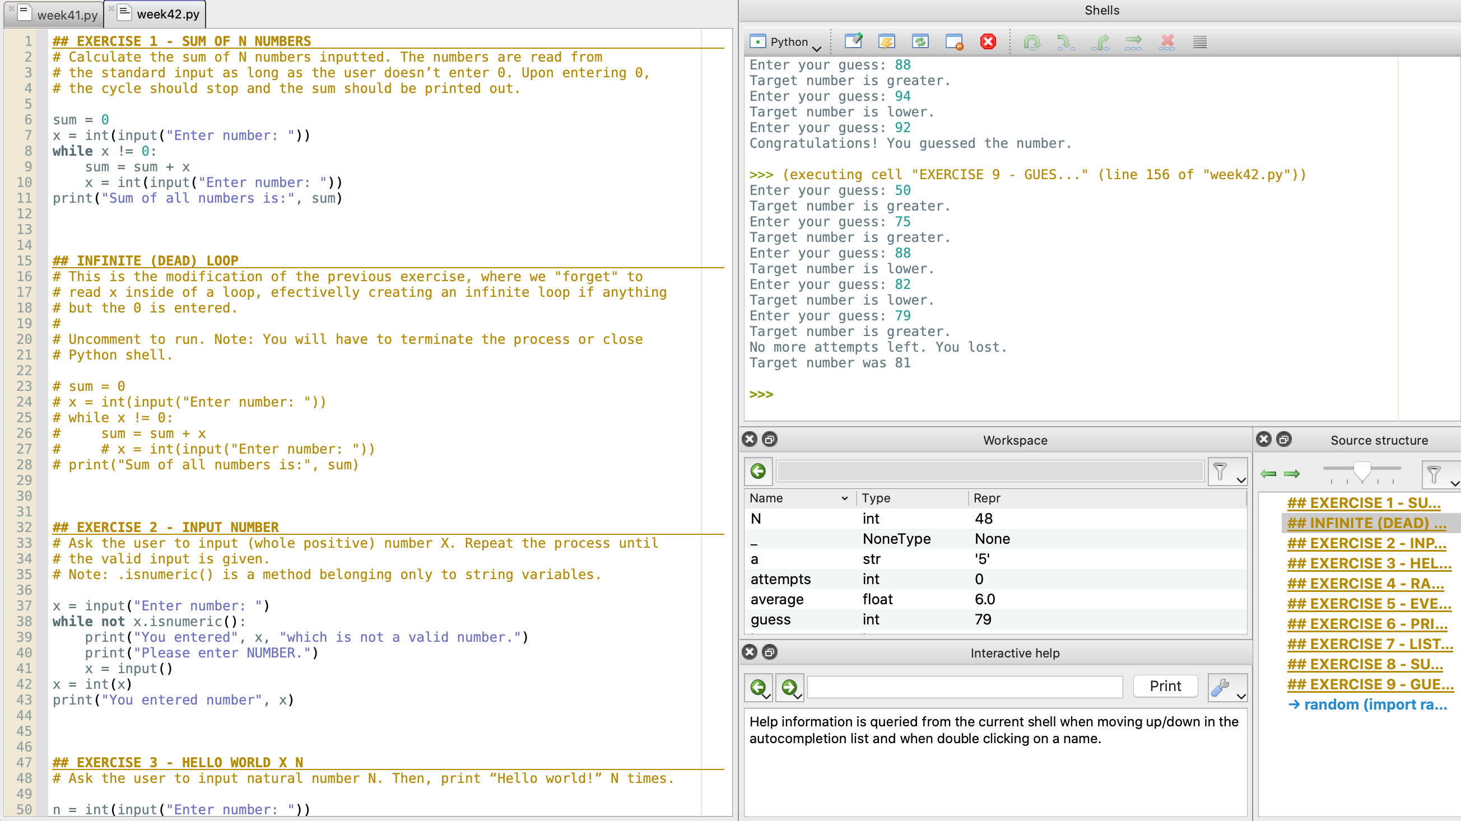
Code for the exercises 1-9
Python code for exercises 1-9 can be found in the file week42-B.py.
Either copy-paste each exercise into a new file and then run it.
Or comment out the parts you don’t need, and execute the entire file.
If you are using Pyzo, each exercise is given as a separate cell (starts with ##). You can run a single cell by clicking inside it and choosing Run → Execute cell from the menu.
Pyzo also allows you to highlight one section of the code and execute it line-by-line in the shell. For that option, highlight the code you want, then choose: Run → Execute selection.

Slide 57
Summary Quiz
What is similar and what is different between branching and cyclic algorithms?
How many times are steps executed inside of a cyclic algorithm?
What is iteration?
How many iterations are there in cycles with condition checked before the body? How many iterations in those where the condition is checked after the body?
What is while loop? When are steps in the while loop executed and how many times?
What is typically done before entering the loop?
What is infinite or dead loop?

Slide 58
Summary
Similar to branching algorithms, cyclic algorithms have condition and body. If the condition is evaluated as true, the steps in the body will be executed. If not, the steps in the body will be skipped. However, once the steps in the body have been executed, the algorithm will “jump back” to the condition again and perform the evaluation.
Steps in cyclic algorithm can be executed once, multiple times or never.
One iteration is the execution of all steps in the body of the cyclic algorithm.
Cycles where the condition is checked after the body can have 1 or more iterations. Cycles where the condition is checked before the body can have 0 or more iterations.
While loop is a control flow statement. As long as the condition is satisfied, the steps in the body of while loop will be executed repeatedly.
In almost every case, we have to initialize some variables before entering the loop.
If the algorithm is forever stuck in the cycle, we call it infinite / dead loop.

